Slide 1
Confident Learners
Overview for Parents and Caregivers

Slide 2

Your child is participating in the Confident Learners Literacy Program!
Confident Learners is a literacy program for Grades 1-5 that develops children’s basic reading skills.
It will help them become successful learners!

Slide 3
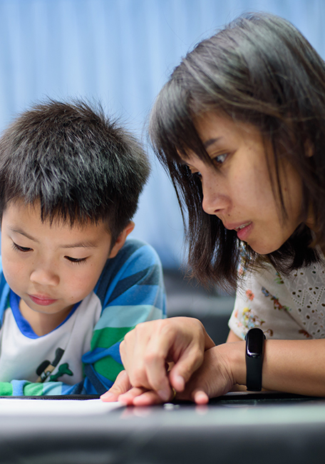
Why is our school using Confident Learners?
It’s important to learn to read with confidence in the first few years of school.
This has a direct impact on your child’s well-being and successful school outcomes.
Children learn to read so they can then read to learn.

Slide 4

A step-by-step approach
Confident Learners uses a step-by-step and direct approach to teach children how to read.
Children learn the alphabet and what sounds each letter or letters make, like “b” makes a /b/ sound, and “ch” makes a /ch/ sound.
Children quickly learn how to sound out words, make simple sentences, and read short texts. They are not just guessing – they are breaking the ‘reading code’!

Slide 5
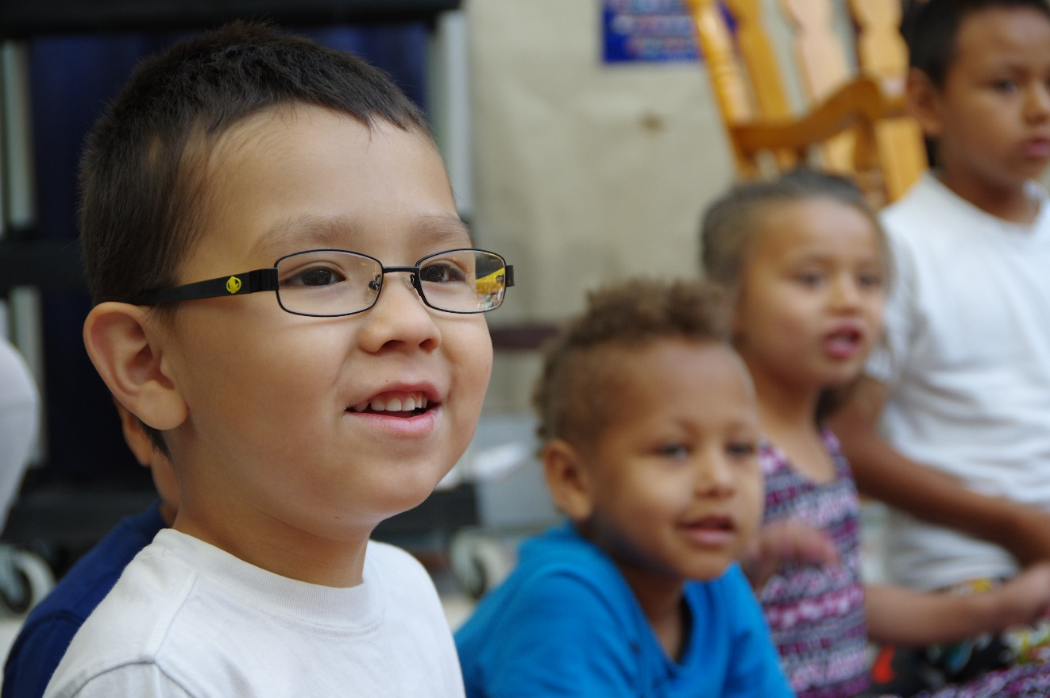
A step-by-step approach
Children then learn about different spellings of a sound like f, ff, and ph for the /f/ sound, and different parts of a word like the prefix “re” in recreate.
Finally, they learn strategies to understand what they are reading like finding answers to the questions who, what, where, when, why, and how.

Slide 6
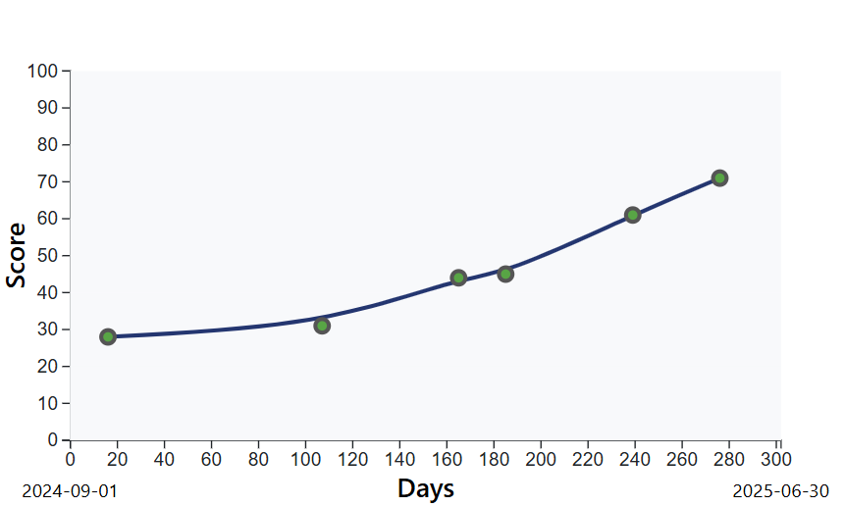
Monitoring your child’s reading growth
Reading growth is tracked with checkpoints throughout the year using the Phonics Advantage Reading Assessment (PARA).
We can quickly understand your child's skills, and see:
  what they can do
  which skills to teach next
  how well they are progressing

Slide 7
Optional: add an image of your school’s Growth Chart (Balloon Chart) here!

Slide 8
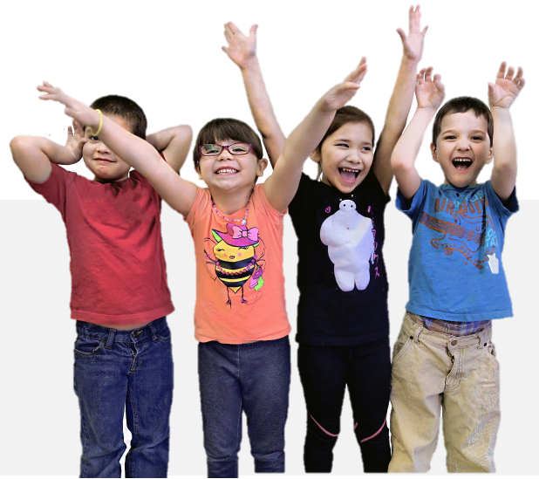
An inclusive program that supports all children
Confident Learners is different from other programs:
It helps children advance quickly in a matter of weeks.
It includes over 200 fun and targeted lessons for teachers to use.
Staff receives literacy and leadership coaching support.
Confident Learners helps us support every child.

